Slide 1
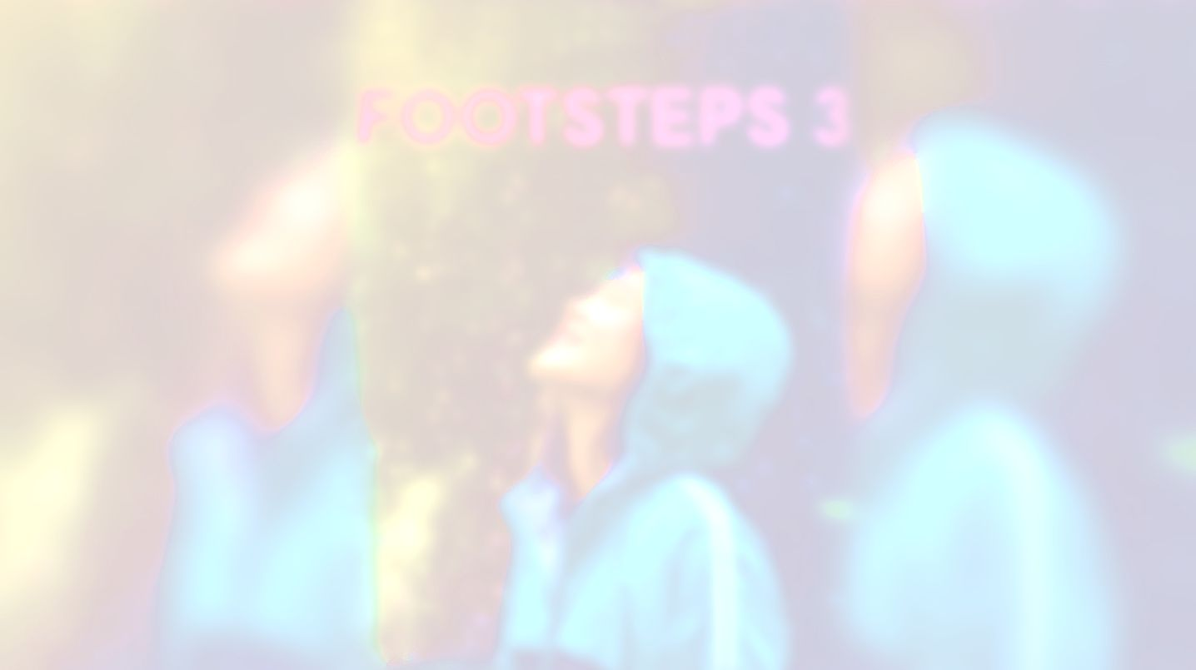
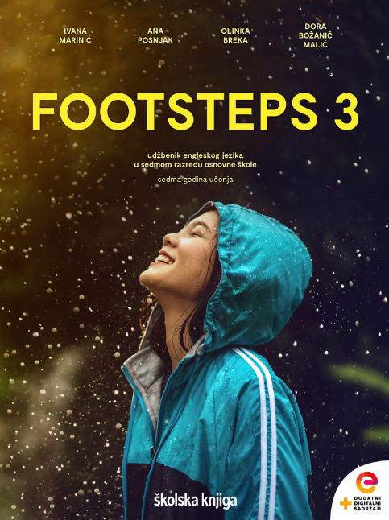

UNIT 5; It takes drive
Self-check 5

Slide 2
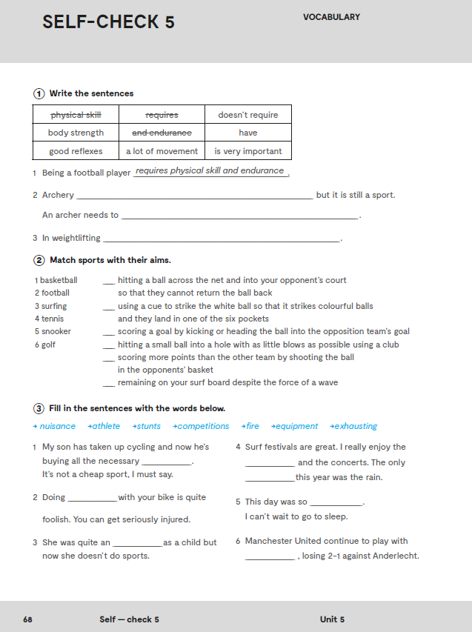
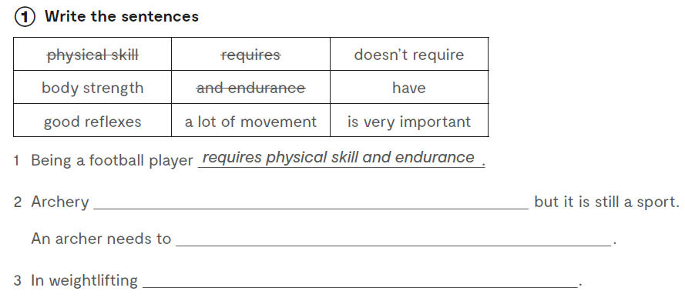
Workbook, p. 68
doesn’t require a lot of movement
have good reflexes
body strength is very important

Slide 3
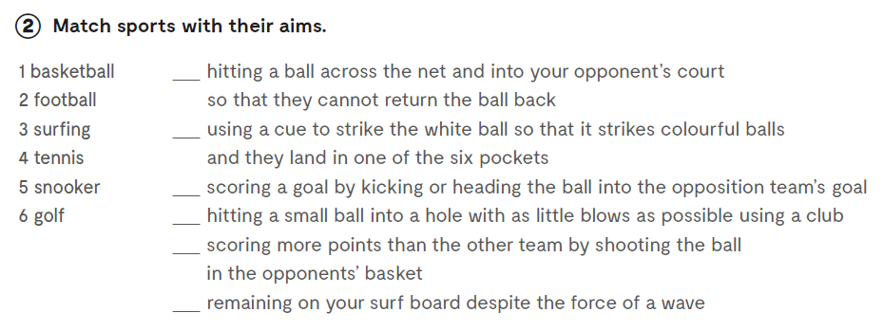
4
5
2
6
1
3

Slide 4
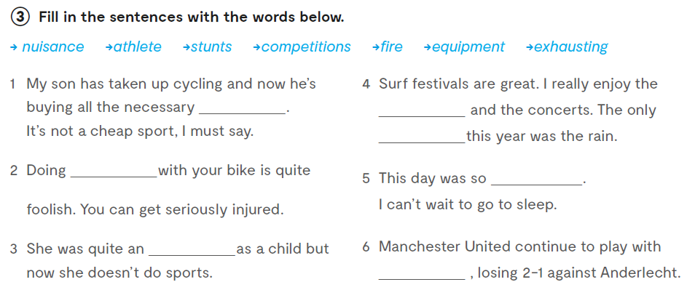
equipment
nuisance
competitions
exhausting
stunts
athlete
fire

Slide 5
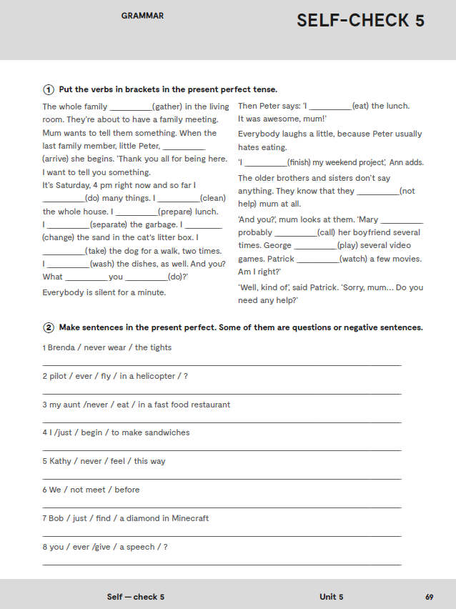
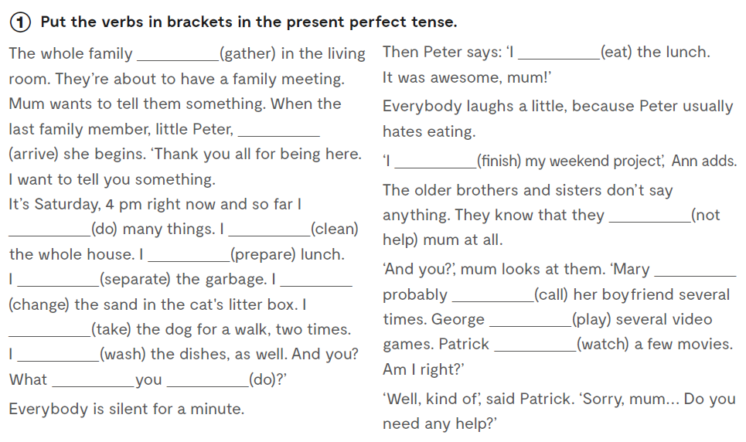
has gathered
have eaten
has arrived
have finished
haven’t helped
have done
have cleaned
have prepared
have separated
have changed
has
called
has played
have taken
has watched
have washed
have done

Slide 6
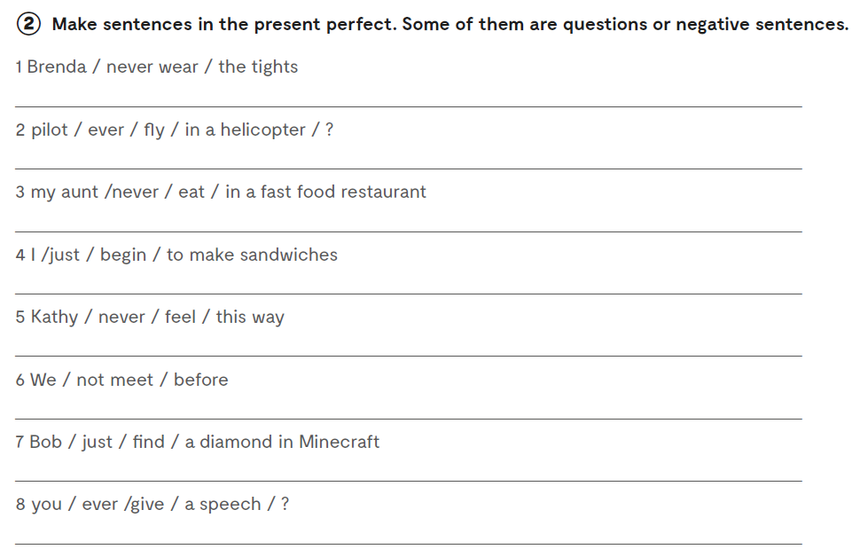
Brenda has never worn tights.
Has the pilot ever flown in a helicopter?
My aunt has never eaten in a fast food restaurant.
I have just begun to make sandwiches.
Kathy has never felt this way.
We have not met before.
Bob has just found a diamond in Minecraft.
Have you ever given a speech?

Slide 7
Let’s practise: https://wordwall.net/play/889/716/507
https://wordwall.net/play/889/761/551
https://wordwall.net/play/889/871/238

Slide 8
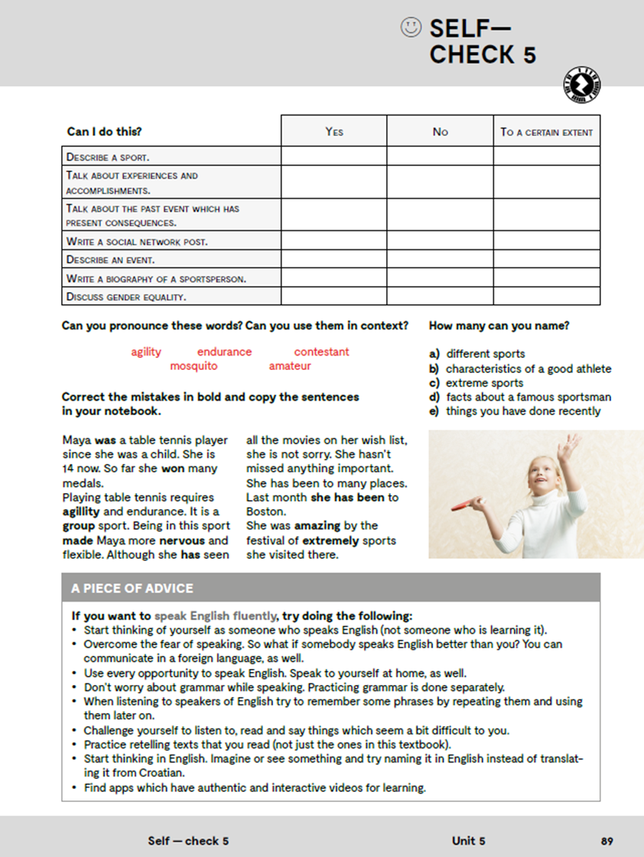
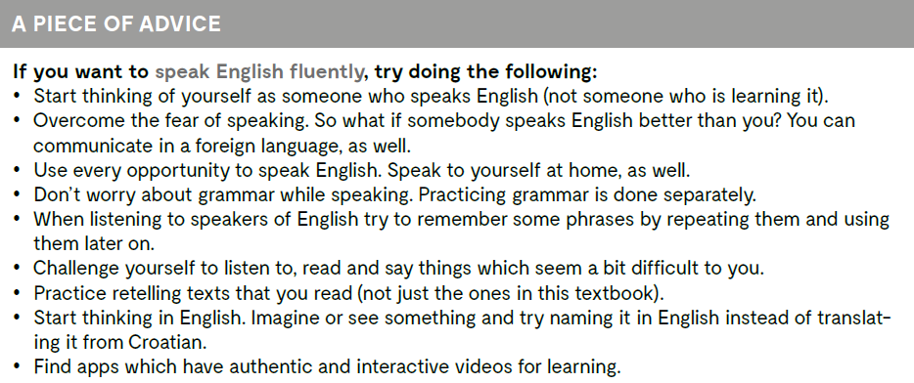

Slide 9
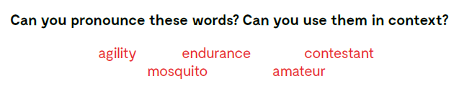
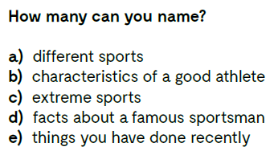

Slide 10
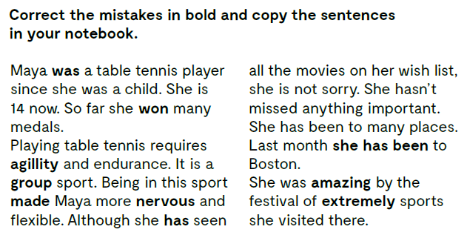
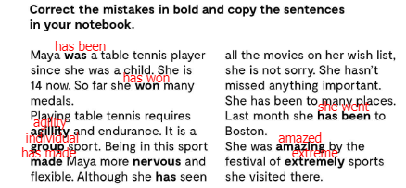

Slide 11
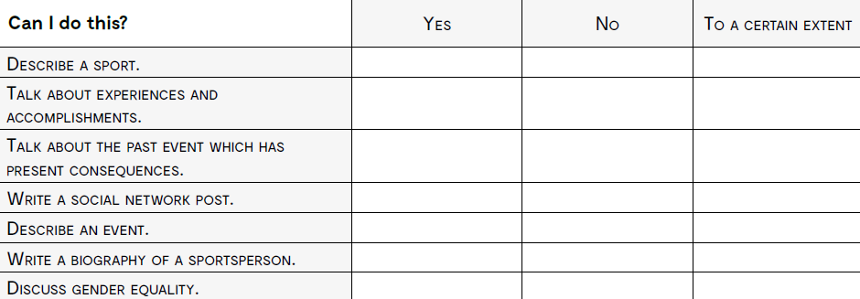
opisati sport?
razgovarati o iskustvima i postignućima?
razgovarati o događaju iz prošlosti koji ima posljedice u sadašnjosti?
napisati objavu na društvenim mrežama?
opisati neki dogaađaj?
napisati biografiju sportaša?
raspravljati o ravnopravnosti spolova?

